Slide 1
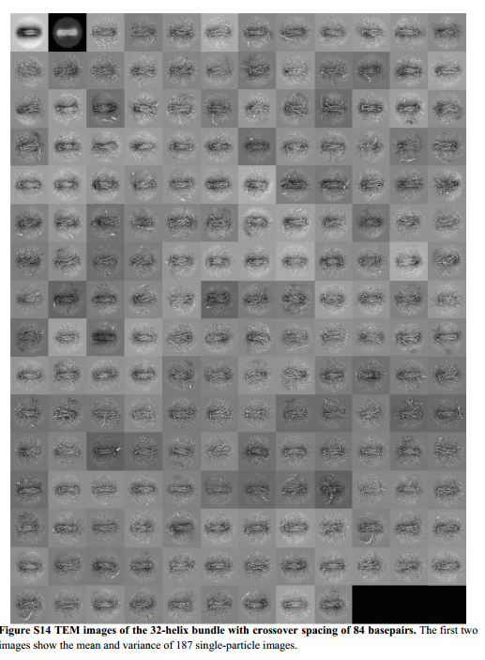
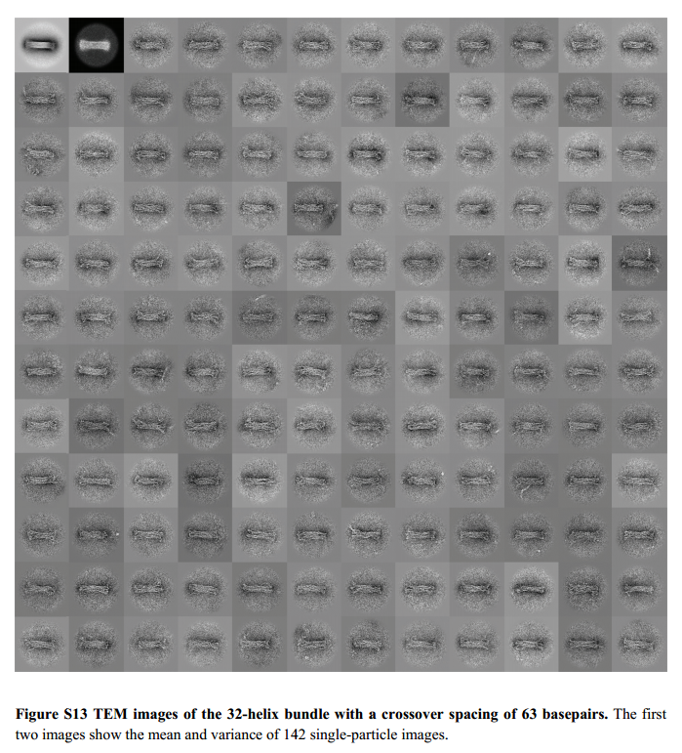
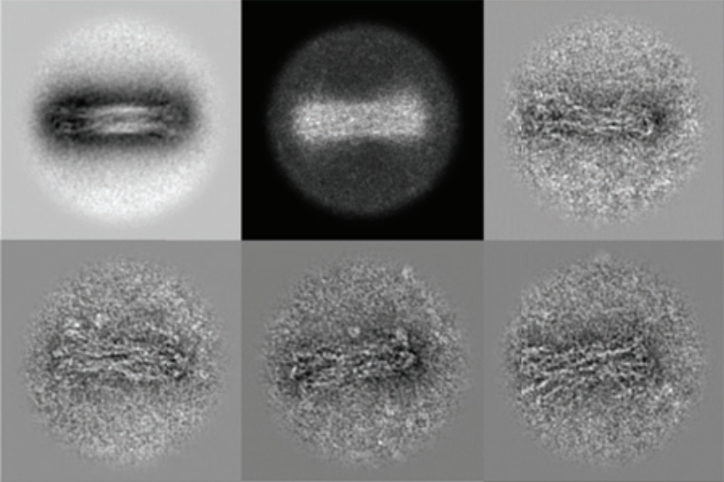
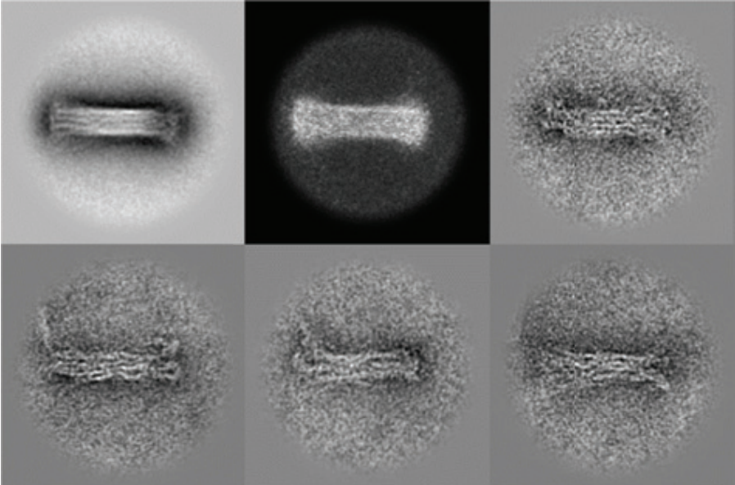
Imaging of Rotary Motor using TEM Quantitative prediction of 3D solution shape and flexibility of nucleic acid nanostructures, H. Dietz, Nucleic Acids Research, 2011
Miran Liber, Hadas Volkov
hadasvol@post.bgu.ac.il
11/16

Slide 2
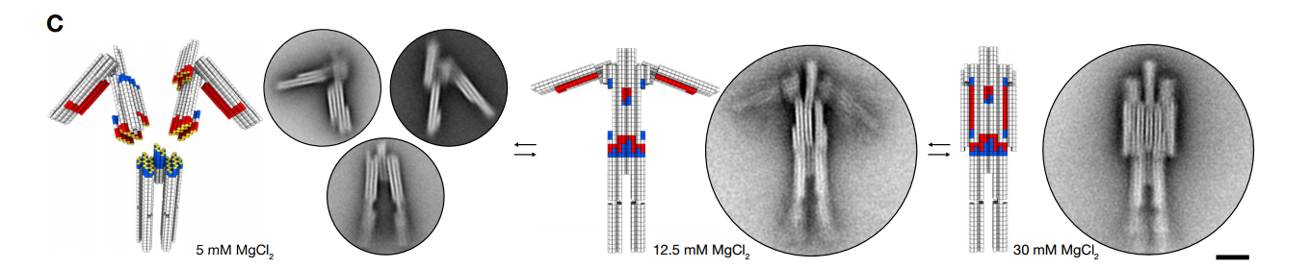
Reversibly reconfigurable non–base pairing multistate DNA devices with arbitrary shapes.
Dynamic DNA devices and assemblies formed by shape-complementary, non–base pairing 3D components. H. Dietz, Science 2015

Slide 3
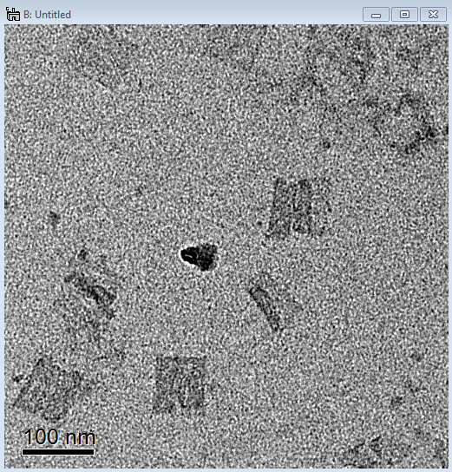
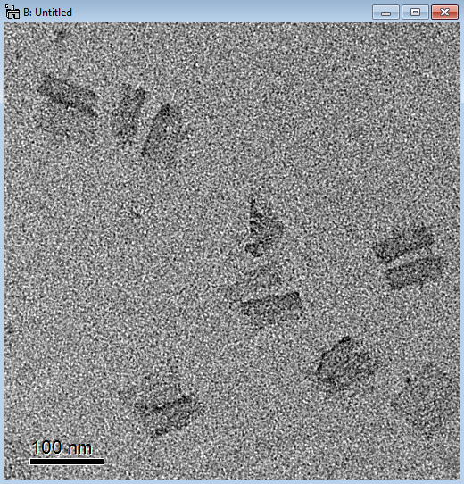
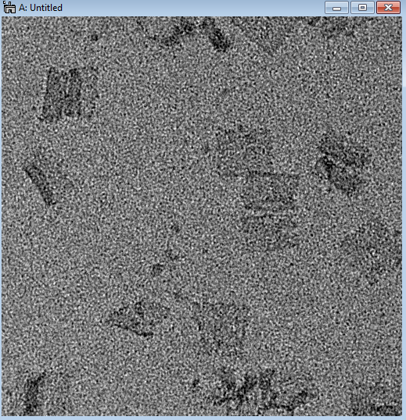
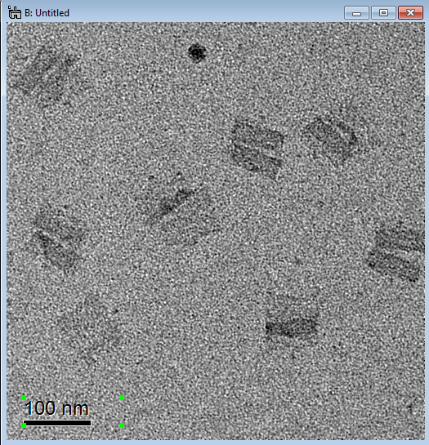
Characterization of Dimers from TEM Images
The third dimension in DNA Origami structure, Miran Liber
Double
Smeared
Butterfly
Width of both sides:
31.7±2.1 nm

Slide 4
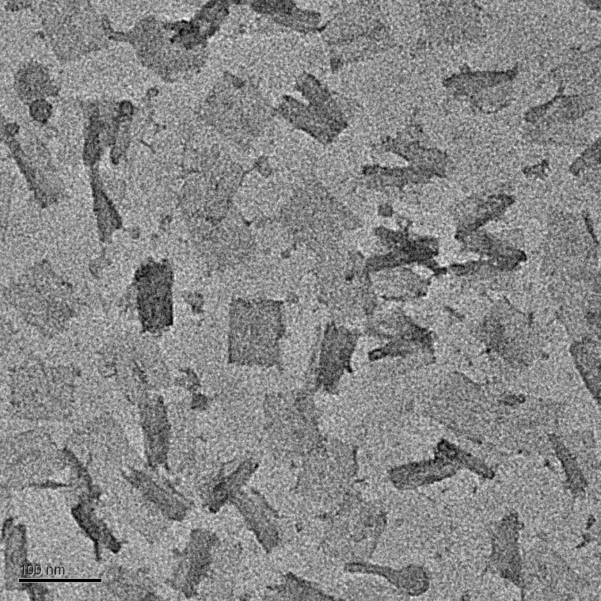
Characterization of Dimers from TEM Images
The third dimension in DNA Origami structure, Miran Liber

Slide 5
TEM Images of Dimer Reaction Of Regular Origami
Butterfly
Single
Smeared
Single
Double
Single
47.2%
Double
45.8%
Unknown
7.0%
Butterfly
55.6%
Double
22.2%
Smeared
22.2%

Slide 6
TEM Sample preparation protocol Multilayer DNA Origami Packed on Hexagonal and Hybrid Lattices, W.M. Shih, JACS, 2011
TEM studies. The TEM sample was prepared by dropping 3.5µL of sample solution on a
carbon-coated grid (400 mesh, Ted pella). Before depositing the sample, the grids were
negatively glow discharged for 45 seconds. After 2 minutes, the sample was wicked from
the grid by touching its edge with a piece of filter paper. Then the grid was touched with
a drop of 2 % uranyl formate solution and excess solution was wicked away with a filter
paper. Again the grid was touched with a second drop of uranyl formate solution for 20
seconds, and the excess solution was removed with a filter paper. TEM studies were
conducted using a JEOL JEM-1400 transmission electron microscope, operated at 80 kV
on bright field mode.

